Slide 1
C++ 11

Slide 2
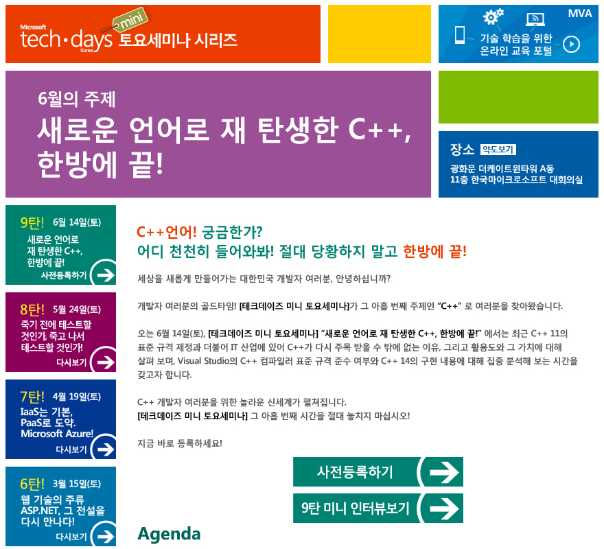
http://www.microsoft.com/ko-kr/events/techdaysminisat/default.aspx

Slide 3
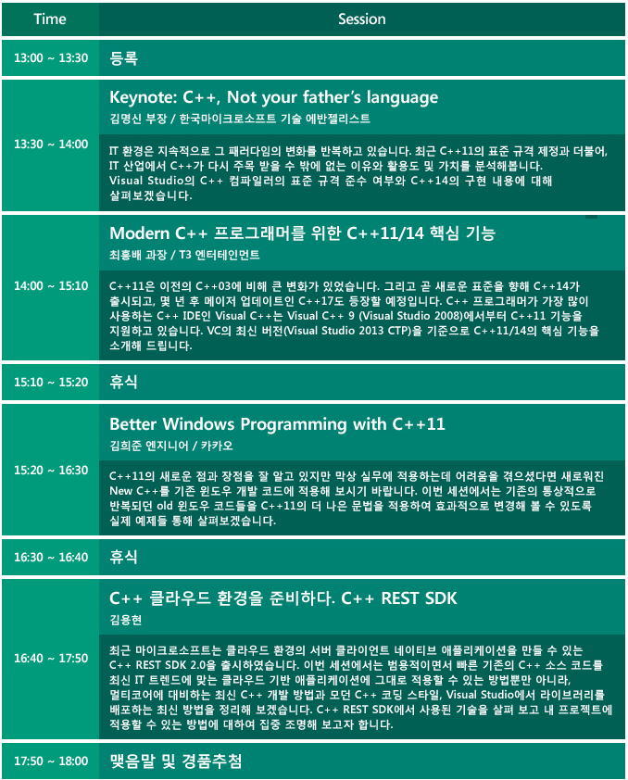


Slide 4
C++11 Support
Windows VC++
http://msdn.microsoft.com/ko-kr/library/hh567368.aspx
Linux GCC
http://gcc.gnu.org/projects/cxx0x.html

Slide 5
C++11 Features
auto
lambdas
rvalue references (move semantics)
thread
async
default/delete
const_expr
random
lock_guard
call_once
…

Slide 6
References
Boost 라이브러리와 C++11
최흥배
C++11
NHN NEXT 이선협

Slide 7
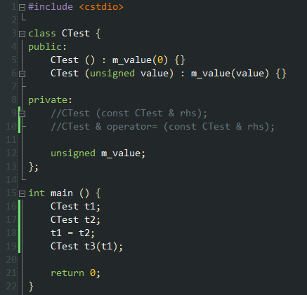
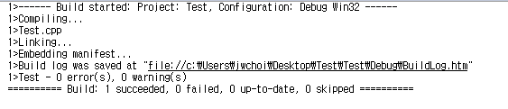

Slide 8
